Slide 1
Long sequence of climax
Chengming

Slide 2

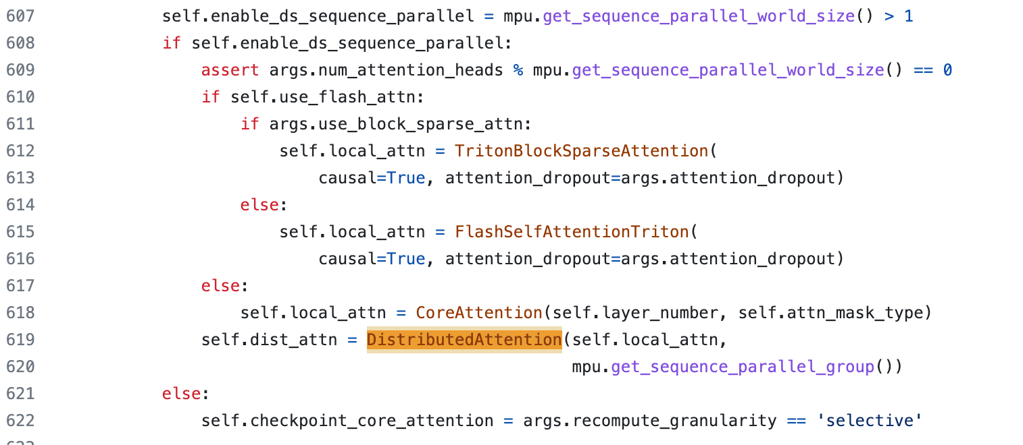
How to use deepspeed sequence parallel

Slide 3
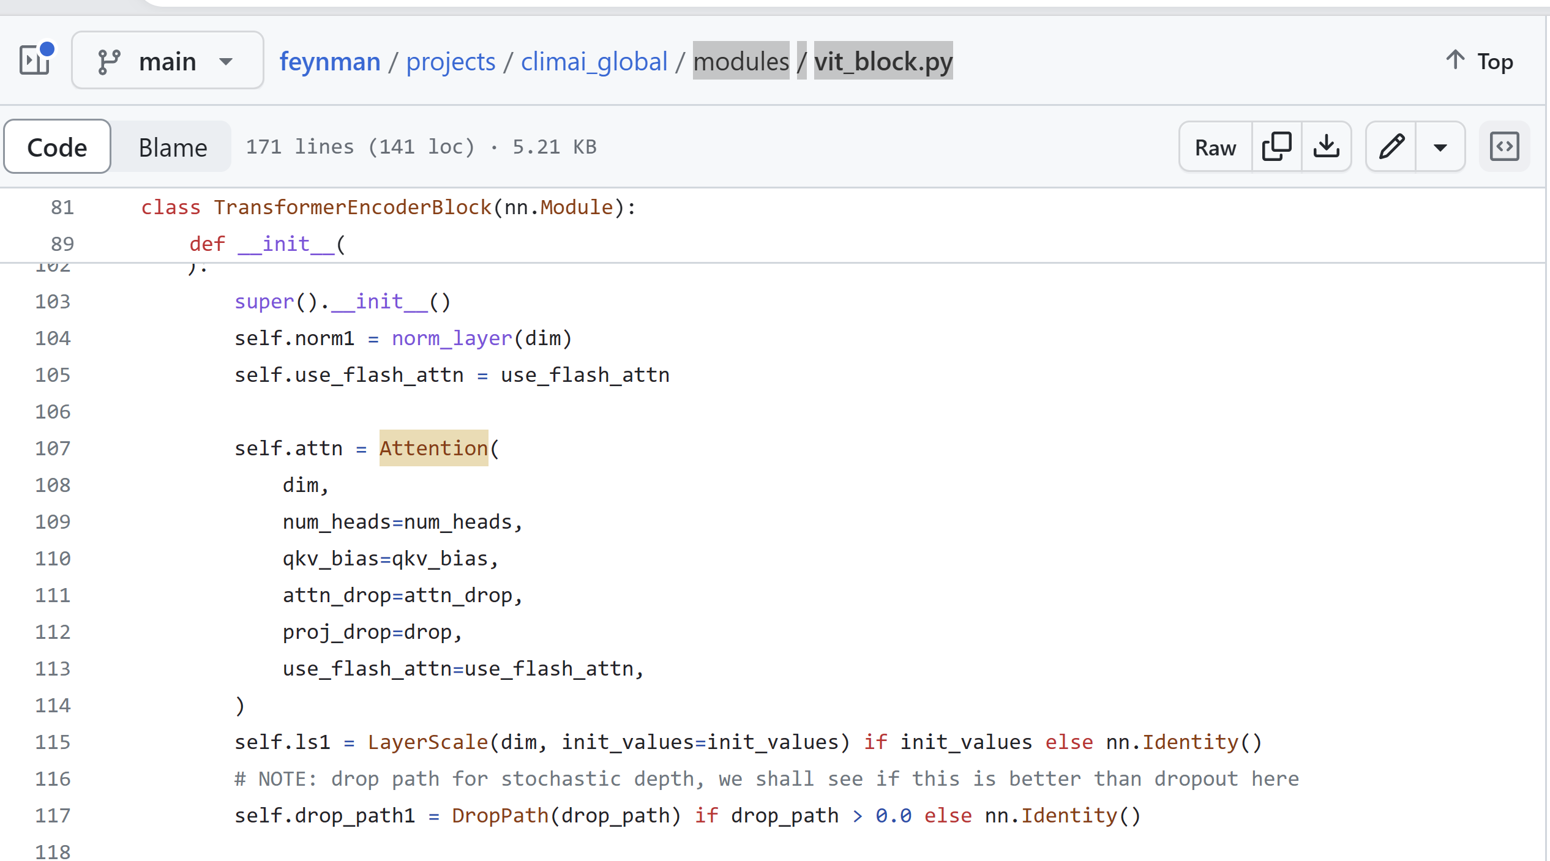
How to add deepspeed sequence parallel
In modules/vit_block.py

